Slide 1
HBase - Architecture

Slide 2
Why HBase?
It can store huge amounts of data in a tabular format for extremely fast reads and writes.
HBase is mostly used in a scenario that requires regular, consistent insertion and overwriting of data.
HBase Real Life Connect - Example
You may be aware that Facebook has introduced a new Social Inbox integrating email, IM, SMS, text messages, and on-site Facebook messages. They need to store over 135 billion messages a month.
Facebook chose HBase because it needed a system that could handle two types of data patterns:
An ever-growing dataset that is rarely accessed
An ever-growing dataset that is highly volatile You read what's in your Inbox, and then you rarely look at it again.
Notes:
We know that HDFS stores, processes, and manages large amounts of data efficiently.
However, it performs only batch processing where the data is accessed in a sequential manner. This means one has to search the entire dataset for even the simplest of jobs. Hence, a solution was required to access, read, or write data any time regardless of its sequence in the clusters of dat

Slide 3
Characteristics of HBase
HBase is a type of NoSQL database and is classified as a key-value store. Some characteristics of HBase are:
Value is identified with a key.
Both key and values are Byte Array, which means binary formats can be stored easily.
Values are stored in key-orders.
Values can be quickly accessed by their keys
HBase is a database in which tables have no schema; column families and not columns are defined at the time of table creation.

Slide 4
Applications of HBase
There are a number of HBase applications across various industries, from healthcare to e-commerce to sports sector. For instance:
In the healthcare sector, HBase is used for storing genome sequences and disease history of people or a particular area.
In the field of e-commerce, HBase is used for storing logs about customer search history and it also performs analytics and target advertisement for better business insights.
In sports, HBase is used to store match details and the history of each match. It uses this data for better prediction.

Slide 5
Features of HBase
HBase has a number of features like:
Scalable: HBase allows data to be scaled across various nodes as it is stored in HDFS.
Automatic failure support: Write ahead Log across clusters are present that provides automatic support against failure.
Consistent read and write: HBase provides consistent read and write of data.
JAVA API for client access: HBase provides easy to use JAVA API for clients.
Block cache and Bloom filters: It supports block cache and bloom filters for high volume query optimization.

Slide 6
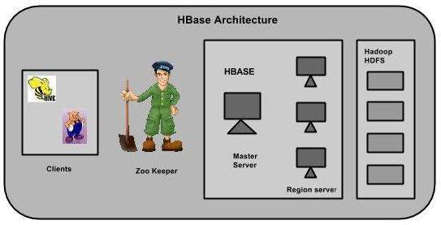
Notes:
In HBase, tables are split into regions and are served by the region servers. Regions are vertically divided by column families into “Stores”. Stores are saved as files in HDFS. Shown below is the architecture of HBase.

Slide 7
HBase has three major components:
the client library
a master server
region servers.
Notes:
Region servers can be added or removed as per requirement.

Slide 8
Master Server
The master server -
Assigns regions to the region servers and takes the help of Apache ZooKeeper for this task.
Handles load balancing of the regions across region servers. It unloads the busy servers and shifts the regions to less occupied servers.
Maintains the state of the cluster by negotiating the load balancing.
Is responsible for schema changes and other metadata operations such as creation of tables and column families.

Slide 9
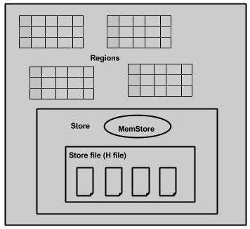
Regions
Regions are nothing but tables that are split up and spread across the region servers.
Region server
The region servers have regions that -
Communicate with the client and handle data-related operations.
Handle read and write requests for all the regions under it.
Decide the size of the region by following the region size thresholds.
Notes:
The store contains memory store and HFiles. Memstore is just like a cache memory. Anything that is entered into the HBase is stored here initially. Later, the data is transferred and saved in Hfiles as blocks and the memstore is flushed.

Slide 10
Zookeeper
Zookeeper is an open-source project that provides services like maintaining configuration information, naming, providing distributed synchronization, etc.
Zookeeper has ephemeral nodes representing different region servers. Master servers use these nodes to discover available servers.
In addition to availability, the nodes are also used to track server failures or network partitions.
Clients communicate with region servers via zookeeper.
In pseudo and standalone modes, HBase itself will take care of zookeeper.

Slide 11
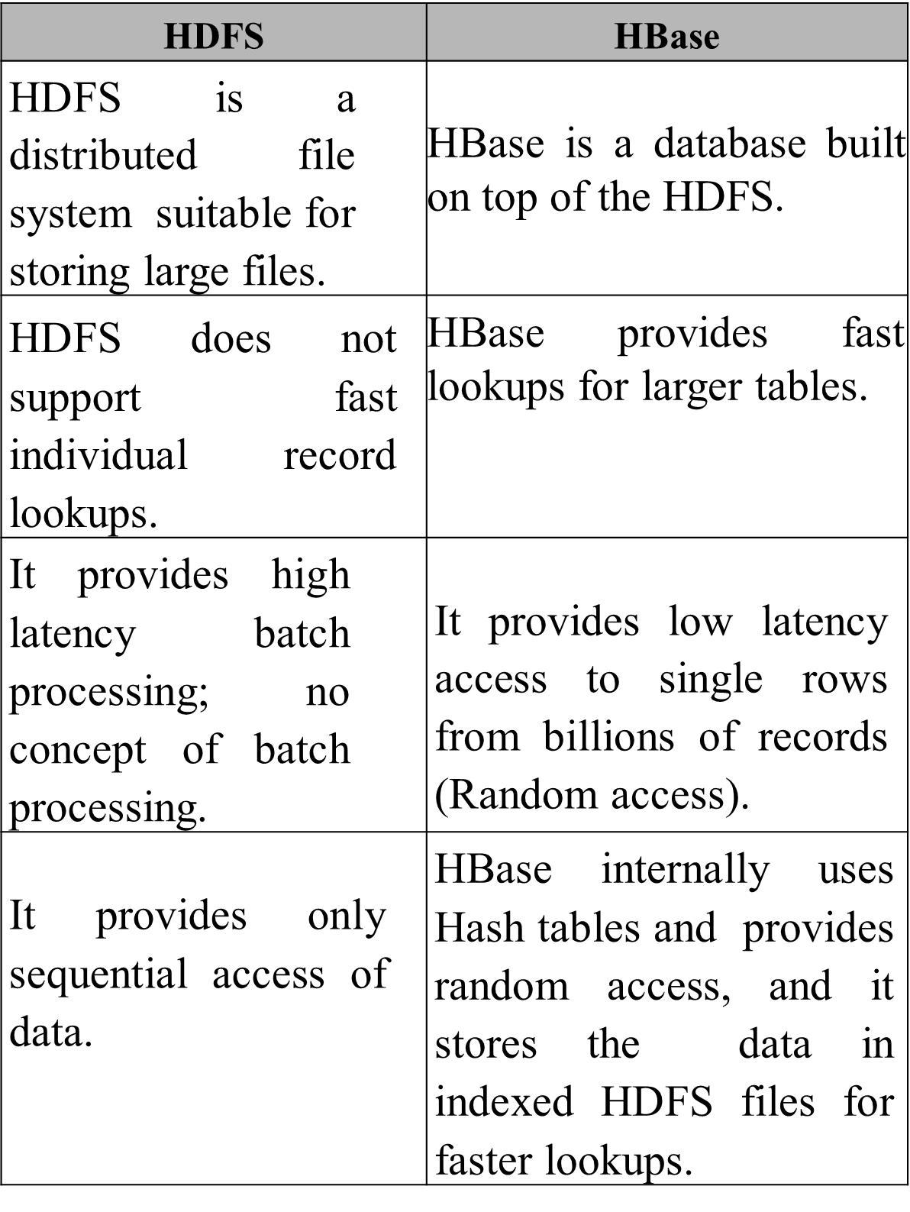

Slide 13
HBase Operations: Read and Write Operations
There is a special HBase Catalog table called the META table, which holds the location of the regions in the cluster. When a client reads or writes data to HBase, the following takes place:
The client gets the Region Server that hosts the META table from ZooKeeper. Then the client will query the .META server to get the region server corresponding to the row key it wants to access. The client caches this information along with the META table location.
It will then get the Row from the corresponding Region Server:

Slide 14
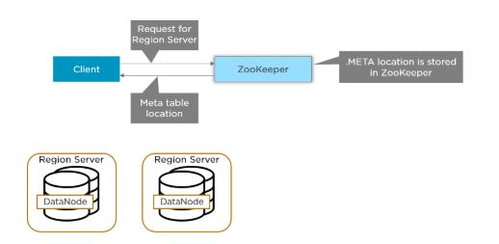

Slide 15
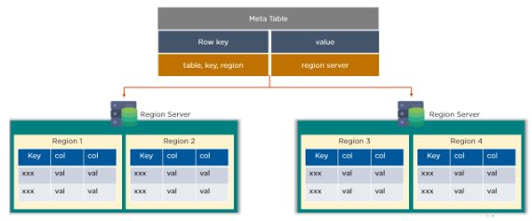
Notes:
In HBase, the table is used to find the Region for a given Table key. Special HBase catalog table that maintains a list of all the Region Servers in the HBase storage system:

Slide 16
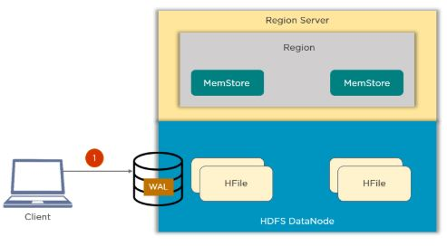
HBase Write Mechanism
Notes:
Write Ahead Log (WAL) is a file used to store new data that is yet to be put on permanent storage. It is used for recovery in the case of failure. When a client issues a put request, it will write the data to the write-ahead log (WAL).

Slide 17
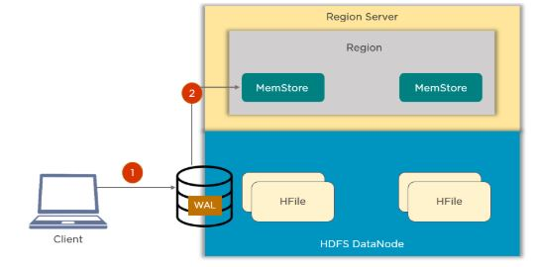
Notes:
MemStore is the write cache that stores new data that has not yet been written to disk. There is one MemStore per column family per region. Once data is written to the WAL, it is then copied to the MemStore.

Slide 18
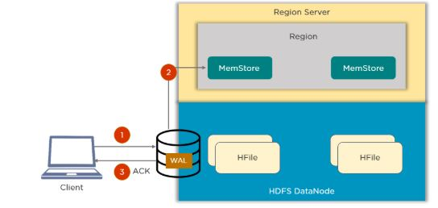
Notes:
Once the data is placed in MemStore, the client then receives the acknowledgment.

Slide 19
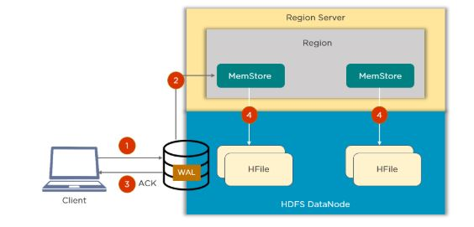
Notes:
Hfiles store the rows of data as sorted KeyValue on disk. When the MemStore reaches the threshold, it dumps or commits the data into an HFile.

Slide 20
Read Operation Flow
Step 1: The client accesses Zookeeper, finds the -ROOT-table, and obtains the .META. table information.
Step 2: Search from the .META. table to obtain the HRegion information of the target data, to find the corresponding HRegionServer.
Step 3: Obtain the data you need to find through HRegionServer.
Step 4: The memory of the HRegionserver is divided into two parts: MemStore and BlockCache. MemStore is mainly used to write data, and BlockCache is mainly used to read data. Read the request first to the MemStore to check the data, check the BlockCache check, and then check the StoreFile, and put the read result into the BlockCache.

